Slide 1

From Deployment to Feedback

Slide 2
Objectives
Understanding Deployment
Understanding Feedback
Data Science Methodology

Slide 3
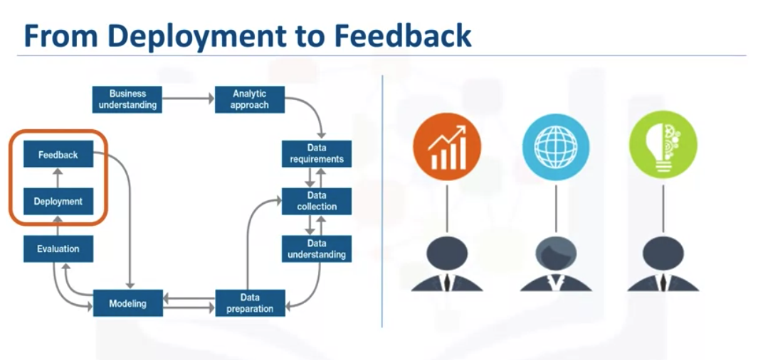
Understanding Deployment
Data Science Methodology

Slide 4
Understanding Deployment
Once the model is evaluated and the data scientist is confident it will work, it is deployed and put to the ultimate test.
Depending on the purpose of the model, it may be rolled out to a limited group of users or in a test environment, to build up confidence in applying the outcome for use across the board.
Data Science Methodology

Slide 5
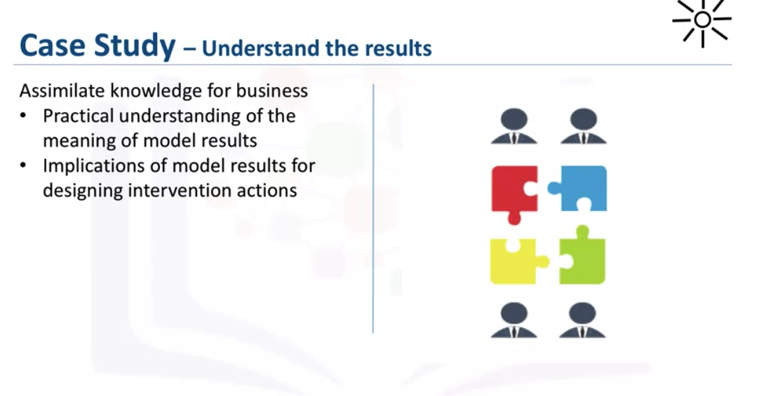
Understanding Deployment
Data Science Methodology

Slide 6
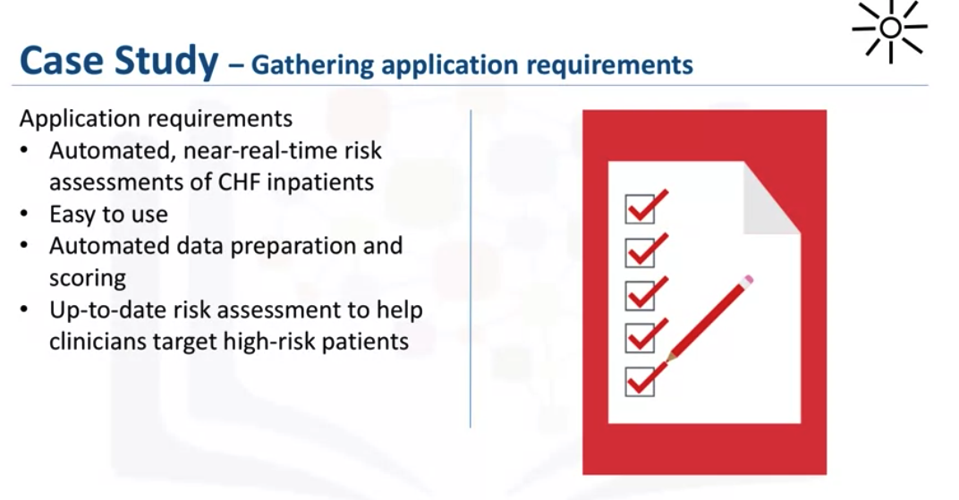
Understanding Deployment
Data Science Methodology

Slide 7
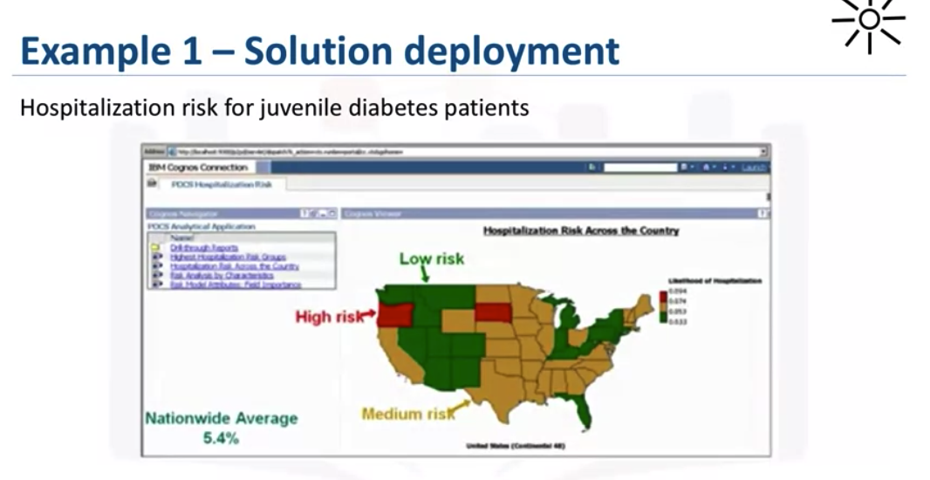
Understanding Deployment
Data Science Methodology

Slide 8
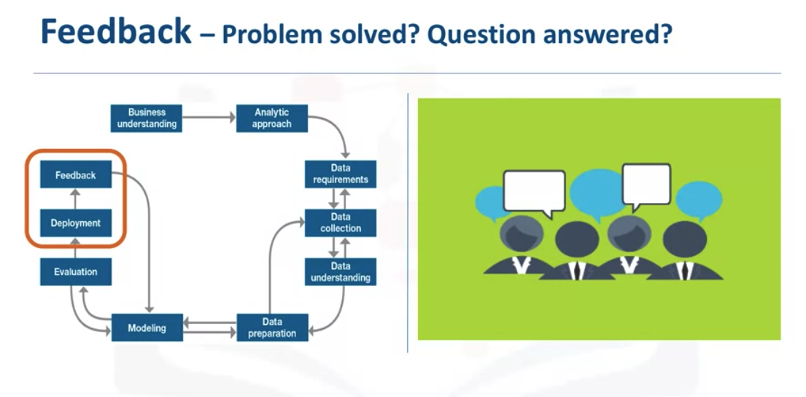
Understanding Feedback
Data Science Methodology

Slide 9
Understanding Feedback
Once in play, feedback from the users will help to refine the model and assess it for performance and impact.
The value of the model will be dependent on successfully incorporating feedback and making adjustments for as long as the solution is required.
The feedback process is rooted in the notion that, the more you know, the more that you'll want to know.
Data Science Methodology

Slide 10
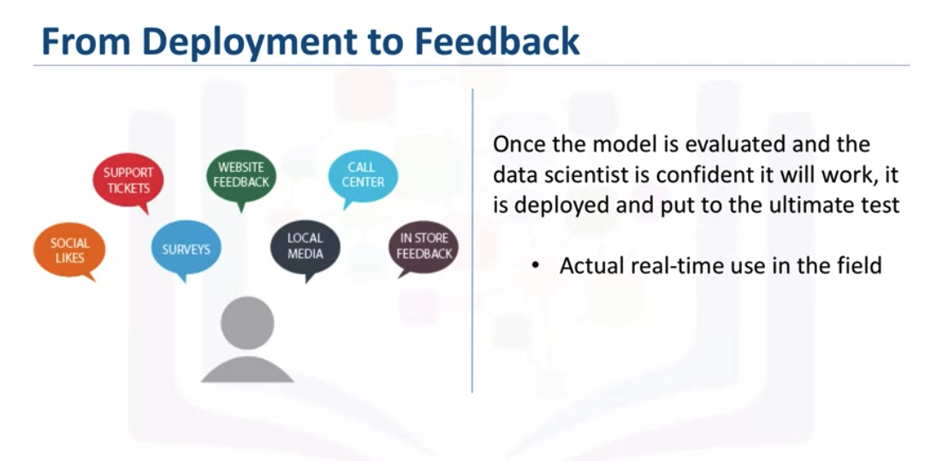
Understanding Feedback
Data Science Methodology

Slide 11
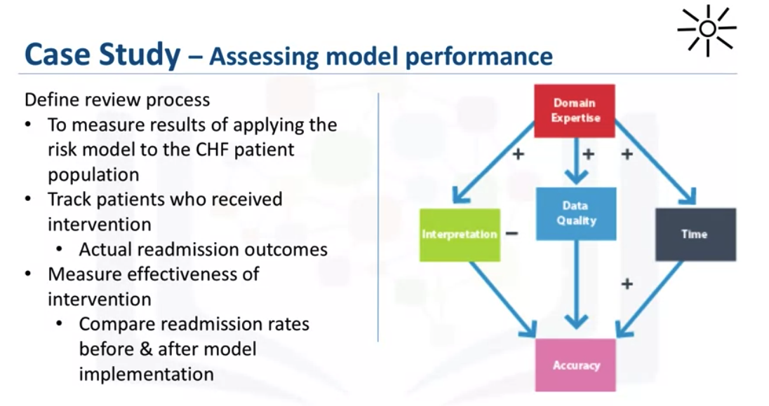
Understanding Feedback
Data Science Methodology

Slide 12
Summary
Understanding Deployment
Understanding Feedback
Data Science Methodology

Slide 13
Q & A
Data Science Methodology

